Slide 1
Short Term Crypto Currency Price Predictor Using ML
Submitted in the partial fulfillment for the award of the degree of
BACHELOR OF ENGINEERING
IN
Artificial Intelligence and Machine Learning
Submitted by:
Aniket Mittal
20BCS6819
Under the Supervision of:
Kushagra Agrawal
Department of AIT-CSE
DISCOVER . LEARN . EMPOWER

Slide 2
Outline
Introduction to Project
Problem Formulation
Objectives of the work
Methodology used
Results and Outputs
Conclusion
Future Scope
References

Slide 3
Introduction to Project
Buying and selling cryptocurrencies like Bitcoin can yield tremendous gains if done correctly. It has proved lucky for many people in the past and is still earning them a lot of money today. But this does not come without its downsides. If not thought and calculated properly, one can lose all your money. There should be an incredible understanding of how and precisely crypto costs change, which suggests that realizing how individuals make their crypto predictions is very important.
Most of the crypto currency and stock market predictions are made using technical analysis, by observing the historical data like opening and closing prices and then making trends to predict future price.

Slide 4
Introduction to Project
In this project I am using LSTM (Long Short Term Model) to predict future price of various Crypto currencies, I also created another model using random forest classifier and then used XGBoost model to predict prices.
The data is collected from yahoo finance (yfinance library in python) of previous 10 years containing OHLC prices (Open, High, Low, Close).
The data is then preprocessed to get ready for testing and training in the model in order to predict future prices.

Slide 5
Problem Formulation
Cryptocurrency is a type of digital currency similar to the dollar, euro and yen. The difference is that instead of being backed by a nation or federal bank, it uses an online ledger with the strong cryptography so to secure online transactions.
Through cryptocurrency exchanges, one can buy and sell cryptocurrency. It can also be "mining". The popularity of cryptocurrencies skyrocketed in 2017 as a result of the several months of exponential growth in their market capitalization.
Crypto currency market is growing like a boom day by day, so short term crypto currency price predictor is a very useful project.

Slide 6
Problem Formulation
As geopolitical and economic issues have escalated over the past two years, global currency values ​​have plummeted, stock markets have seen a poor run and investors have lost their wealth. This has rekindled interest in digital currencies. Our system helps predict the price of cryptocurrencies using machine learning.
This project will help you predict the future price of various crypto currencies based on the historical data of that particular currency, so that it becomes easier and more efficient for a crypto trader to forecast the market and earn money by trading in various Crypto currencies.

Slide 7
Objectives of the Work
The primary objective of this project is to design and implement a robust machine learning model that can accurately predict short-term price movements of cryptocurrencies.
To train the machine learning model using the prepared dataset, employing suitable algorithms such as regression, time series analysis, or deep learning models
Implement a mechanism to enable real-time prediction of cryptocurrency prices based on the trained model. This objective aims to provide users with up-to-date and accurate predictions for informed decision-making.

Slide 8
Methodology used
Data Collection: The data is collected from yahoo finance website using yfinance python library, I collected data of previous 10 years with various features like OHLC prices, volume, etc.
Data Preprocessing: After data collection the data is cleaned by handling missing values, removing the outliers (the features which are not required for prediction), and scaling of features (using Min-Max Scaler).
Model Selection: I used LSTM model (Long Short Term model) and in another approach I used random forest classifier and then used XGBoost model to predict prices.

Slide 9
Methodology used
Model Evaluation: After training the data I am using XGBclassifier for backtesting the results and improving precision score.
Result Analysis and Interpretation: After backtesting and improving precision with various trends the model finally predict the target future prediction.
Ethical Considerations: In my model of crypto currency price predictor I got the precision score of 5.2 which is quiet risky to trade. There are various other factors which can cause the prediction to fail like fundamental factors. So it is a limitation of this project that if there is a new news in the market which can affect the crypto price, then the model prediction will fail.

Slide 10
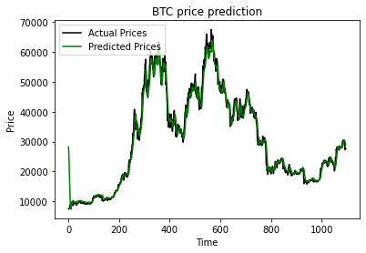
Results and Outputs
In the first model in which I used Long Short Term Model, the results are as follows:
As shown in the image of BTC Price prediction, it the graph of testing dataset, with two features as actual prices and predicted prices plotted with time.
I got high accuracy in this model as in the image.

Slide 11
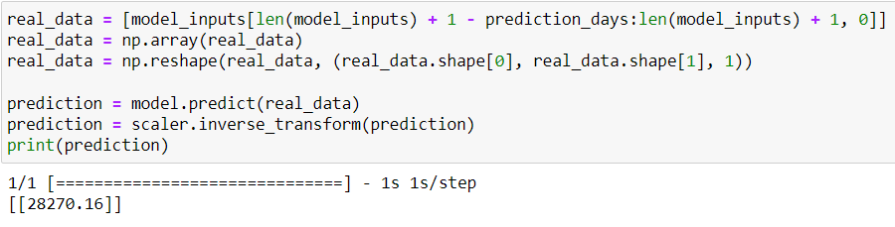
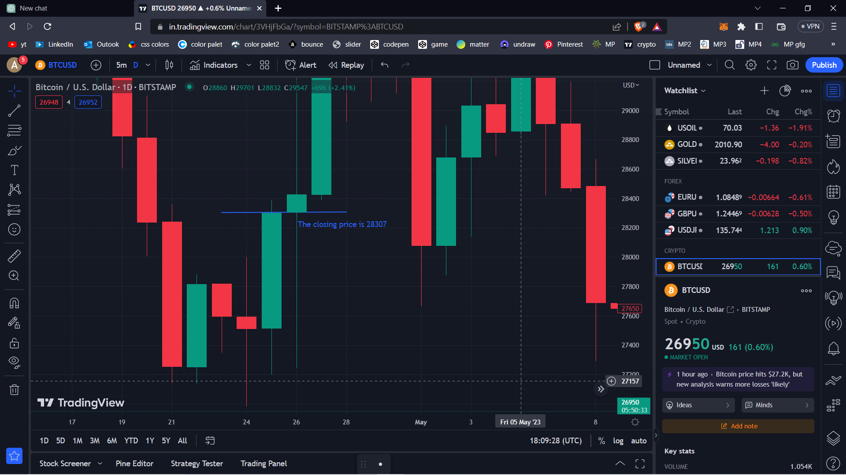
Predicting next day
I run my model on 24th April 2023, to predict for next day i.e. 25th April
It is clearly visible in the above image that the future prediction made by LSTM is 28270.16 US Dollars.
After one day the actual closing price on the trading view is 28307 US Dollars,
Which is very much closer to the predicted price.

Slide 12
Conclusion
In Short term crypto currency price predictor the crypto currency and stock market predictions are made using technical analysis, by observing the historical data like opening and closing prices and then making trends to predict future price.
In this project I used LSTM (Long Short Term Model) to predict future price of various Crypto currencies, I also created another model using random forest classifier and then used XGBoost model to predict prices.
I got the precision score of 5.2 which is quiet risky to trade. There are various other factors which can cause the prediction to fail like fundamental factors. So it is a limitation of this project that if there is a new news in the market which can affect the crypto price, then the model prediction will fail.

Slide 13
Future Scope
Enhanced feature engineering: Explore more advanced techniques for feature engineering to capture additional market trends and indicators. This can include incorporating sentiment analysis from social media, news sentiment analysis, or integrating other relevant financial data sources.
Integration of external factors: Consider incorporating external factors that may influence cryptocurrency prices, such as global economic indicators, regulatory changes, or geopolitical events. This integration can enhance the accuracy of the price prediction model and provide a more comprehensive understanding of market dynamics.
Ensemble models: Experiment with ensemble methods by combining multiple machine learning models to leverage their collective predictive power. Ensemble models, such as random forests or gradient boosting algorithms, can potentially improve the accuracy and robustness of predictions.

Slide 14
References
Garcia, D. & Schweitzer, F. (2015) Social signals and algorithmic trading of Bitcoin. Royal Society Open Science engineering.
Kathyayini, R. S., Jyothi, D. G. & Crypt”. Currency Price Prediction using Machine Learning”. International Journal of Advanced Research in Computer and Communication Engineering.
Alessandretti L, ElBahrawy A, Aiello LM, Baronchelli A (2019) Anticipating cryptocurrency prices using machine learning. Complexity.
Balcilar M, Bouri E, Gupta R, Roubaud D (2017) Can volume predict Bitcoin returns and volatility? A quantiles-based approach. Econ Model.
Cheah ET, Fry J (2015) Speculative bubbles in Bitcoin markets? An empirical investigation into the fundamental value of Bitcoin. Econ Let.

